Slide 1

NGO-ISAC
Identification of Critical Functions
https://www.ngoisac.org/ membership@ngoisac.org

Slide 2
Definitions
Threat Model – Scenarios from data flows.
Data
Physical
Reputational
Critical Functions – can not be replaced easily.
people
software
workflows

Slide 3
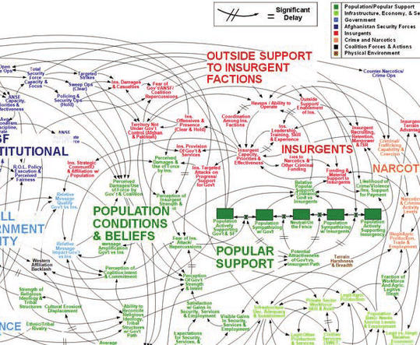
Start with people
org chart
(as built)

Slide 4
Identification of Critical Functions
Identify principals
CISO Chief Information Security Officer (virtual)
named key personnel
incident response lead
department leads
Staff procedure
positively identify staff (DPRK smurfs)
background check
What are the workflows?
typical business day
vs
Disaster recovery/business continuity
Communication Channels

Slide 5
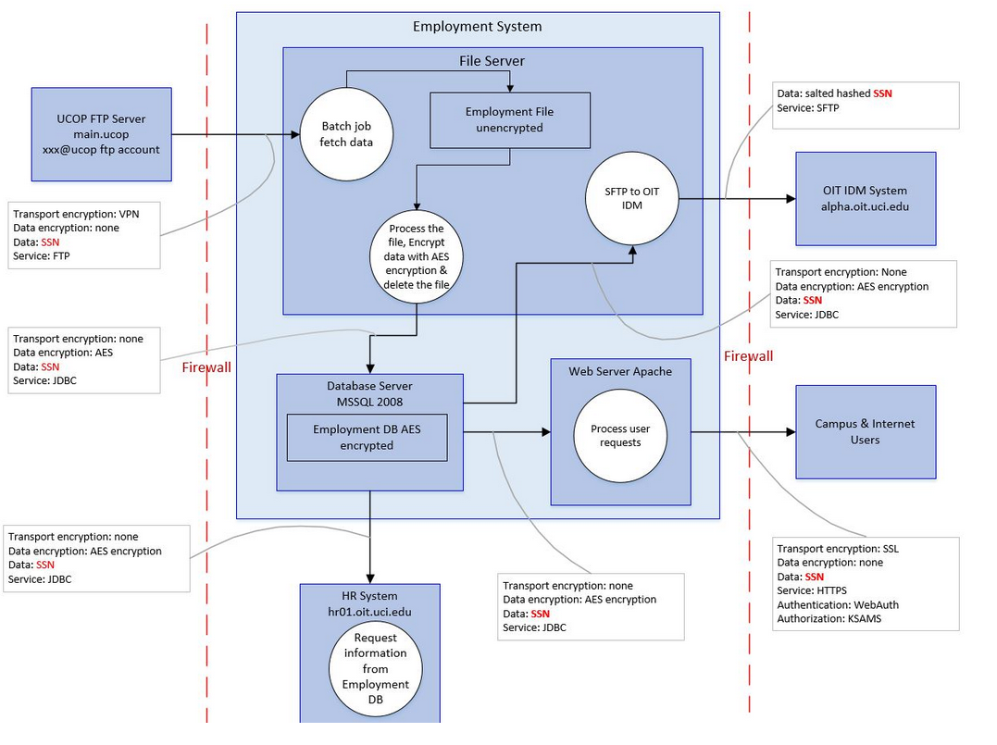
Data Flow Diagrams
DFDs mappings of your organization
work to understand where and how
data / assets / money flow through
your organization.
Resource:
UCI Data Flow Diagram Process
Notes:
Date stamp

Slide 6
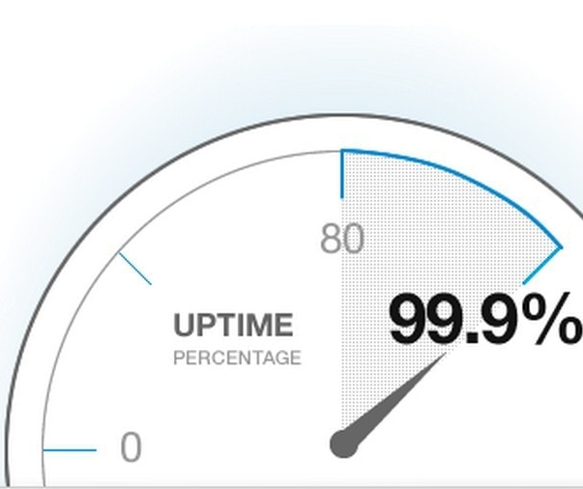
Identification of Critical Functions
monitoring program
who watches the watchers
check the invoices
consequences of unavailability
99.9% ≅ 9 hours a year
worse when composed
(1h, 1d, 1w, 1mo, 1yr, forever)
Recovery Point Objective (RPO)
Recovery Time Objective (RTO)

Slide 7
What problem are we solving?
Understand what you protect.
Being formal in identifying critical functions
identify gaps
Harmonize process vocabulary
First step in building a threat model for you and your organization
shadow IT or non-authorized resource usage
Side effects include saving money!
Threat modeling!

Slide 8
Data Flow Diagram Cycle
Build High Level Architecture Diagram
1
How to DFD
Make an architecture diagram
Identify where outside data is flowing in
Identify internal data processes
Add tags and enrichment
4
2
Enrich flow diagrams
Identify Key Data Flow Features
3
Annotate with internal processes
Notes:
Start with you main business and go down and subdivide all the functions till you feel well covered.

Slide 9
Examples
How do I get paid?
How does money flow in?
How does money flow out?
vetting and reconciliation
revenue recognition
Communication products
Publication pipelines
Social media coordination
Outreach Campaigns

Slide 10
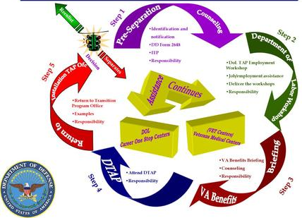
Analyze DFD for deficiencies and weaknesses
DFDs are deficient when processes aren’t understood completely
Don’t understood? Ask for help.
Top Down
Bottom up too!
If you have multiple forms of data flow in a single graph use additional colors to express that flow
You can always dig deeper

Slide 11
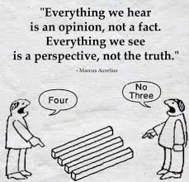
Analyze DFD for deficiencies and weaknesses
DFDs show weaknesses when security assumptions are invalid
Can data and assets can be modified without appropriate oversight or intention?
Are you over-relying on the security of a vendor? Should there be better access controls put in place for that vendor?
Are task that can only be performed by a single individual without backup or oversight?

Slide 12
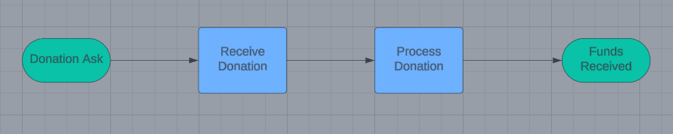
Example Donation DFD Process
(High Level)

Slide 13
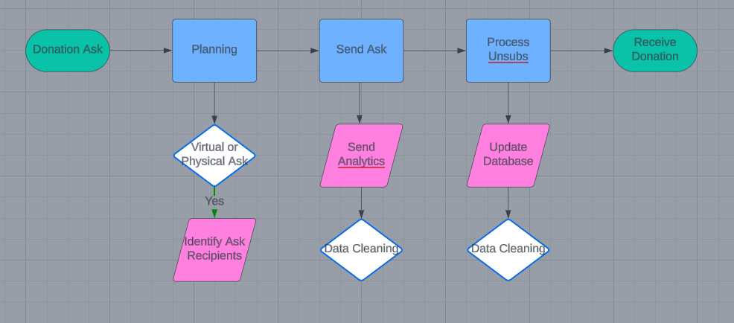
Example DFD Process (Donation Ask Study)
Notes:
Example of one step deeper

Slide 14
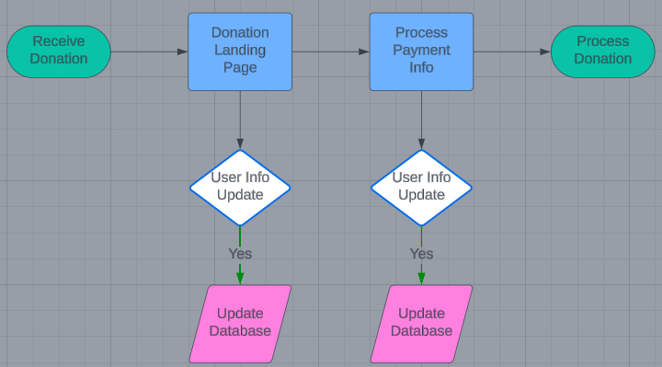
Example DFD Process (Receive Donation Study)

Slide 15
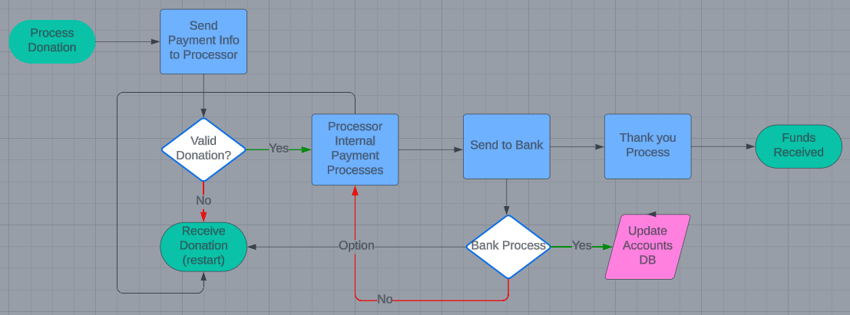
Example DFD Process (Process Donation Study)
Notes:
Let’s analyze this for weaknesses

Slide 16
DFD Process Review
4. Analyze DFDs for weaknesses
1. Draw High Level Diagram.
4
1
3
3 . Get diagram feedback from stakeholders
2. Draw depth studies from High Level Diagram
2
Notes:
End goal have funders for area introduce NGO ISAC to grantees with benefits of collaboration clear
THANK THE AUDIENCE FOR ENABLING THIS TRANSFORMATION

Slide 17
Next Steps – Threat Modeling!
$Actors perform $Actions onto $Assets for $Reasons to accomplish $Outcomes
Look at the interconnections and ask
Impact: “What happens if we lose control of this process?”
Indication: “If an attacker fakes or hijacks an arrow or box how could we tell?”
Models as decision tools:
Is it good? Is it bad?
Should we change?
If we can’t do we accept the risk?”
Recovery Point Objective (RPO)
Recovery Time Objective (RTO)

Slide 18
[ Questions ? ]
We should probably try to do some DFDs right now
Notes:
Be ready for: Constellation, Membership dues

